Slide 1
MobiSys’11
Odessa: Enabling Interactive Perception Applications on Mobile Devices
Moo-Ryong Ra*, Anmol Sheth⁺,
Lily Mummert^{x}, Padmanabhan Pillai’,
David Wetherallº, Ramesh Govindan*
*USC ENL, ⁺Technicolor, ^{x}Google, ‘Intel,
ºUniversity of Washington

Slide 2
Emerging Mobile Perception Applications
Sensing
Sensing
Accelerometer
HD Camera
GPS
Computation
Communication
Dual-Core CPU
Cloud Infrastructure
Sensing Applications
Activity
Recognition
Health, Traffic
Monitoring
Location-Based Service
Participatory
Sensing
Mobile Interactive Perception Application
Motivation
Problem
Measurement
Design
Evaluation

Slide 3
Vision-based Interactive Mobile Perception Applications
Face
Recognition
Object and Pose
Recognition
Gesture
Recognition
Motivation
Problem
Measurement
Design
Evaluation

Slide 4
Common Characteristics
Interactive
Crisp response time ( 10 ms ~ 200 ms)
High Data-Rate
Processing video data of 30 fps
Compute Intensive
Computer Vision based algorithms
Motivation
Problem
Measurement
Design
Evaluation

Slide 5
Enabling Mobile Interactive Perception
Performance
Throughput
Makespan
Application | Throughput | Makespan
Face Recognition | 2.50 fps | 2.09 s
Object and Pose Recognition | 0.09 fps | 15.8 s
Gesture Recognition | 0.42 fps | 2.54 s
All running locally on mobile device
Video of 1 fps
Motivation
Problem
Measurement
Design
Evaluation

Slide 6
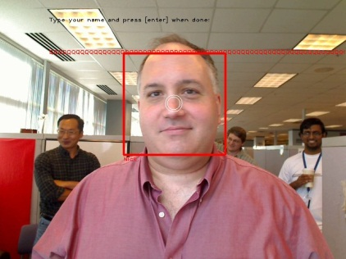
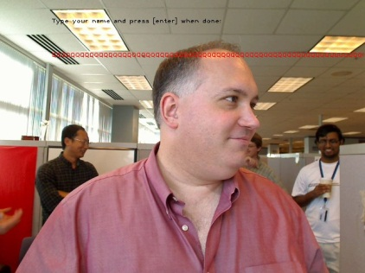
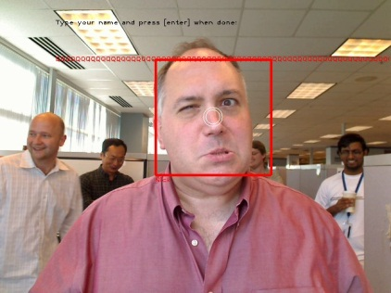
Two Speed-up Techniques
Pipeline Parallelism
Data Parallelism
Offloading
Network
Application Data Flow Graph
Screen
Frame 3
Frame 2
Frame 1

Slide 7
Main Focus
Data Flow Structure
System Support
Offloading
Parallelism
Enable Mobile Interactive Perception Application
Motivation
Problem
Measurement
Design
Evaluation

Slide 8
Contributions
What factors impact offloading and parallelism?
Measurement
How do we improve
throughput and makespan simultaneously?
Odessa Design
How much benefits can we get?
Evaluation
Motivation
Problem
Measurement
Design
Evaluation

Slide 9
Measurement
Input Data Variability
Varying Capabilities of Mobile Platform
Network Performance
Effects of Parallelism
Motivation
Problem
Measurement
Design
Evaluation

Slide 10
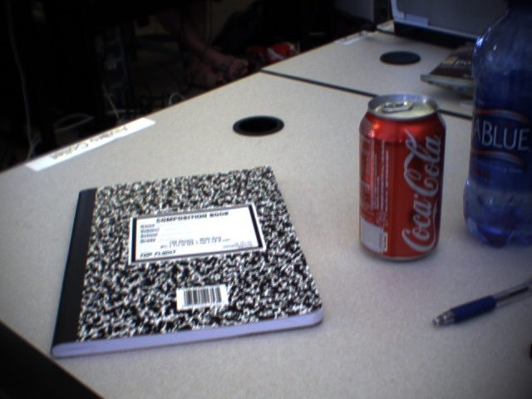
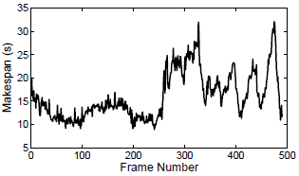
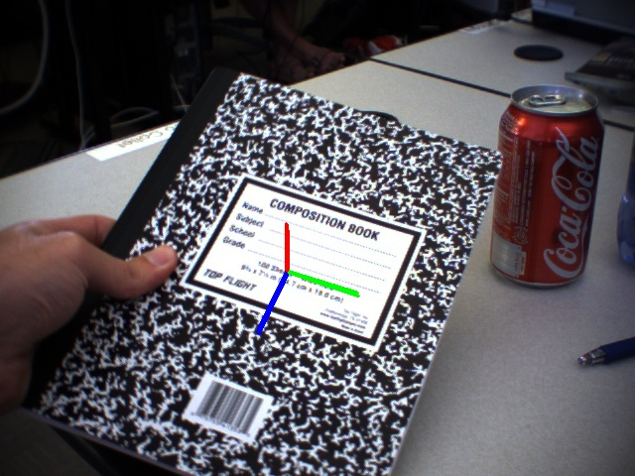
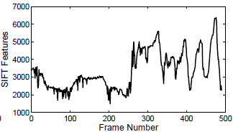
Lesson I : Input Variability
Face Recognition
Object and Pose Recognition
The system should adapt
to the variability at runtime
Impact of input variability
Motivation
Problem
Measurement
Design
Evaluation

Slide 11
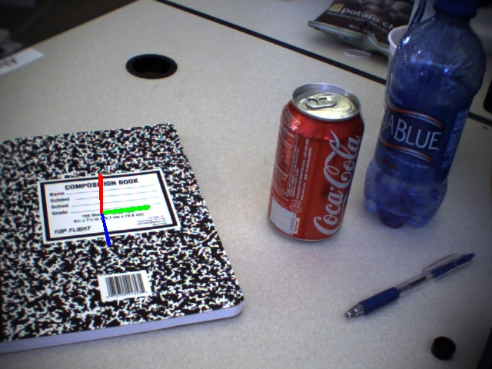
Lesson II: Effects of Data Parallelism
Object and Pose Recognition
# of Threads | Thread 1 | Thread 2 | Thread 3
1 | 1,203 ms | - | -
2 | 741 ms | 465 ms | -
3 | 443 ms | 505 ms | 233 ms
The level of data parallelism affects
accuracy and performance.
Input
Complexity
Segmentation
Method
Motivation
Problem
Measurement
Design
Evaluation

Slide 12
Summary: Major Lessons
Offloading decisions must be made
in an adaptive way.
The level of data parallelism
cannot be determined a priori.
A static choice of pipeline parallelism can
cause sub-optimal performance.
Motivation
Problem
Measurement
Design
Evaluation

Slide 13
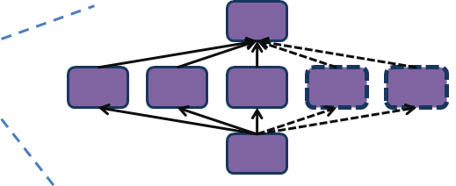
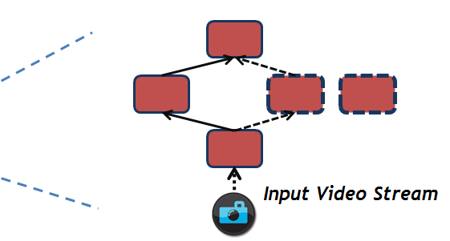
Odessa
Offloading DEcision System for Streaming Applications
Application
Odessa Profiler
Sprout
Cloud Infrastructure
Network
Application
Odessa
Runtime
Profiler
Decision
Engine
Odessa
Sprout
Mobile Device

Slide 14
Incremental Decision Making Process
Cloud Infrastructure
B2
B1
C
A
Network
B
C
A
Application Data Flow Graph
>
Incremental decisions adapt quickly to input and platform variability.
Screen
Local
Execution
Cost
Remote
Execution
Cost
Smartphone

Slide 15
Evaluation Methodology
Implementation
Linux / C++
Experiments
1-core Netbook
2-core Laptop
8-core Server
Odessa Adaptation
Canned Input Data
Resulting Partitions
Performance Comparison
Motivation
Problem
Approach
Design
Evaluation

Slide 16
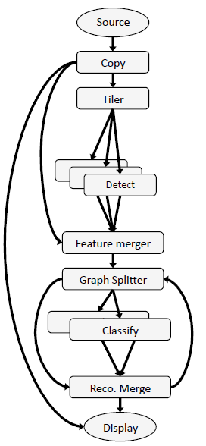
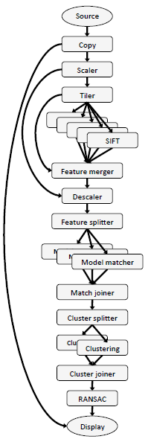
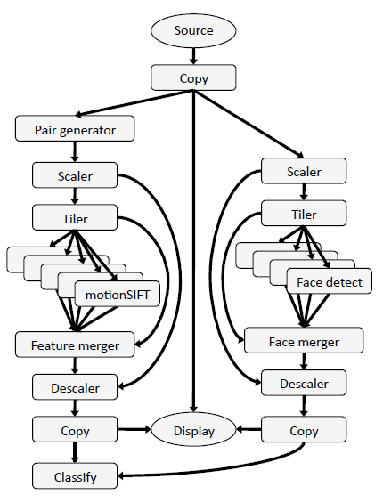
Data-Flow Graph
Face Recognition
Object Pose Estimation
Gesture Recognition
Motivation
Problem
Measurement
Design
Evaluation

Slide 17
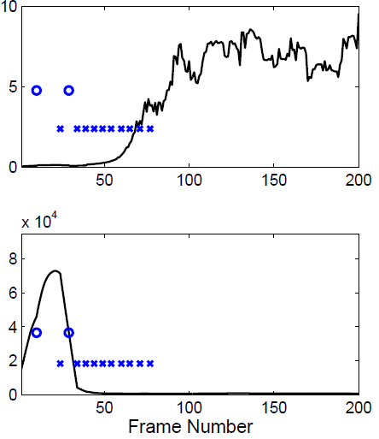
Odessa Adaptation
Object and Pose Recognition
8-core
Machine
FPS
Odessa finds a desirable configuration
automatically.
Network
Makespan
1-core
Mobile Device
Motivation
Problem
Approach
Design
Evaluation

Slide 18
Resulting Partitions in Different Devices
Face Recognition
Client Device | Stage Offloaded and Instances | Degree of Pipeline Parallelism
Mobile Device | Face detection (2) | 3.39
Dual Core Notebook | Nothing | 3.99
Resulting partitions are often very different
for different client devices.
Gesture Recognition
Client Device | Stage Offloaded and Instances | Degree of Pipeline Parallelism
Mobile Device | Face Detection (1) Motion-SIFT Feature (4) | 3.06
Dual Core Notebook | Face Detection (1) Motion-SIFT Feature (9) | 5.14
Motivation
Problem
Approach
Design
Evaluation

Slide 19
Performance Comparison with Other Strategy
Object and Pose Recognition Application
Strategy | Throughput (FPS) | Makespan (Latency)
Local | 0.09 | 15,800 ms
Offload-All | 0.76 | 4,430 ms
Domain-Specific | 1.51 | 2,230 ms
Offline-Optimal | 6.49 | 430 ms
Odessa | 6.27 | 807 ms
Odessa performs 4x better than
the partition suggested by domain expert,
close to the offline optimal strategy.
Mobile Device
Motivation
Problem
Approach
Design
Evaluation

Slide 20
Related Work
ILP solver for saving energy: [MAUI] [CloneCloud]
Graph-based partitioning: [Gu’04] [Li’02] [Pillai’09] [Coign]
Static Partitioning: [Wishbone] [Coign]
A set of pre-specified partitions: [CloneCloud] [Chroma] [Spectra]
Objectives
Variability
Migration,
Contention
Parallelization
Odessa
Motivation
Problem
Approach
Design
Evaluation

Slide 21
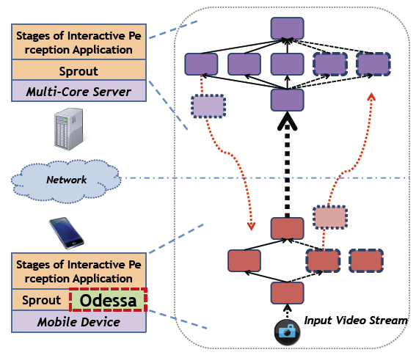
Summary of Odessa
Adaptive & Incremental runtime for mobile perception applications
Odessa system design using novel workloads.
Understanding of the factors which contribute to the offloading and parallelism decisions.
Extensive evaluation on prototype implementation.

Slide 22
Thank you
“Any questions?”

