Slide 1
MobiSys 2012
Medusa: A Programming Framework for Crowd-Sensing Applications
Moo-Ryong Ra, Bin Liu
Tom La Porta, and Ramesh Govindan

Slide 2
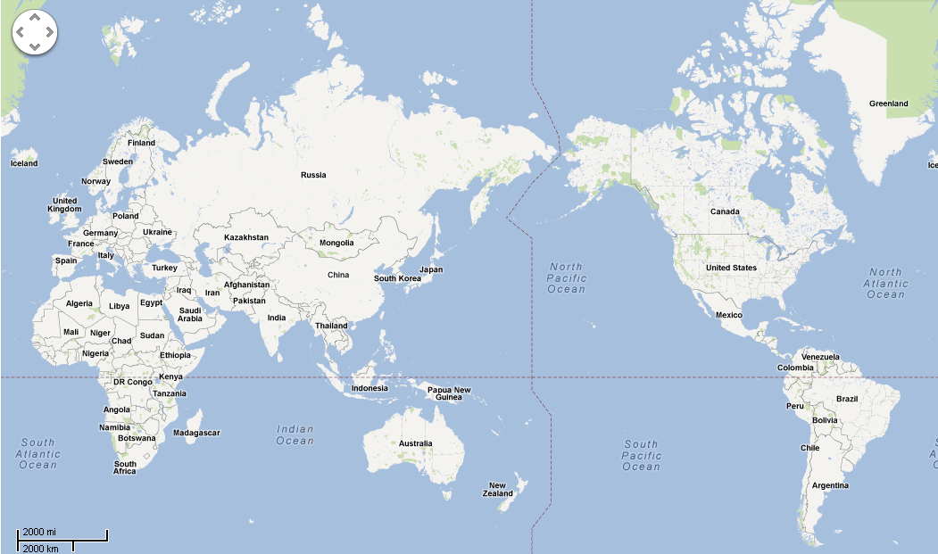
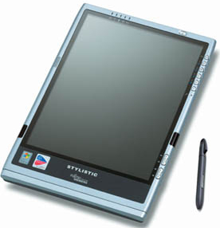
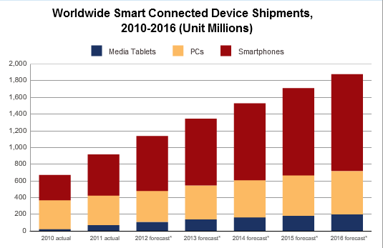
Crowd-Sensing
Crowds
Sensing
2016
Camera/Mic.
2012
GPS/WPS
Accelerometer
Compass/Gyro
Growing Smartphone Users
Proximity
Motivation
Problem
Design
Evaluation
Conclusion

Slide 3
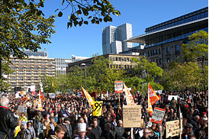
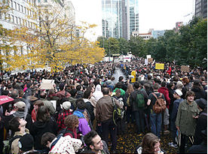
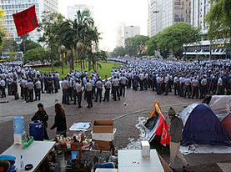
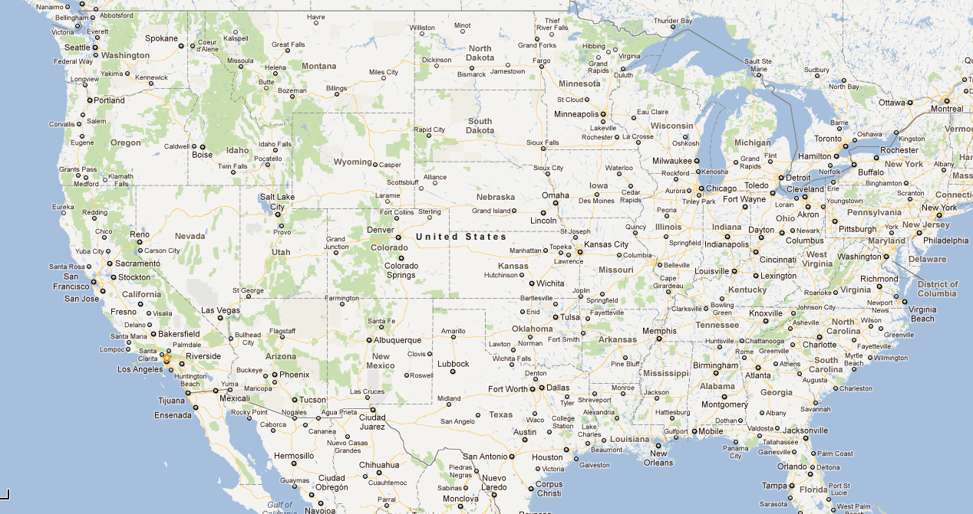
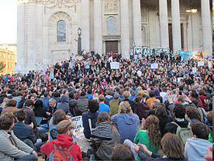
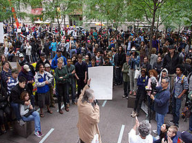
Example: Documenting Social Events
User
Summaries
Full Videos
Worker
Worker
Worker
Worker
Worker
Worker
Motivation
Problem
Design
Evaluation
Conclusion

Slide 4
Other Crowd-Sensing Tasks
Auditioning
Television producer
wants potential actors
to submit clips of
their acting.
Collaborative
Learning
Mobile app developer
wants samples of
activities to train
classifier.
Security personnel
wants to find pictures
of attack taken by
mall visitors.
Forensic
Analysis
Motivation
Problem
Design
Evaluation
Conclusion

Slide 5
The Problem
Recruiting Workers
Stage 1
Providing Incentives
Can be extremely
labor-intensive
Stage 2
Coordinating worker actions
Stage 3
Gathering contributions
Stage 4
Automation using a high-level programming system
Motivation
Problem
Design
Evaluation
Conclusion

Slide 6
Contributions
Describe crowd-sensing requirements
Devise design principles
Design and implement Medusa,
a programming system for crowd-sensing
Evaluate using qualitatively different tasks
Motivation
Problem
Design
Evaluation
Conclusion

Slide 7
Crowd-Sensing Requirements
Expressivity
Runtime
Worker Mediation
Privacy
Access Stored Data
Concurrent Tasks
Unsynchronized Execution
In-network Processing
Anonymity
Extensibility
Robustness
Timeliness Support
Sandboxing
Incentives
Secure Communication
Resource Usage Controls
Motivation
Problem
Design
Evaluation
Conclusion

Slide 8
Runtime Design Principles
Partitioned Services
Cloud
Runtime
Task Management
Worker Recruiting
Incentive Management
Opt-in Data
Transfer
Cloud (Server)
Mobile Devices
Client
Runtime
Sensing
In-network Processing
Dumb Smartphone
Motivation
Problem
Design
Evaluation
Conclusion

Slide 9
Medusa Design
MedScript
Programming Language
Medusa Runtime
Motivation
Problem
Design
Evaluation
Conclusion

Slide 10
Expressivity of MedScript Language
Video
Documentation
Trigger
HIT stage
SPC stage
Preview outgoing data
Sensing
Processing
Communication
Recruit
Curate
TakeVideo
ExtractSummary
UploadSummary
UploadVideo
Incentives
Worker Mediation
XML-based extensible language
Motivation
Problem
Design
Evaluation
Conclusion

Slide 11
Other Language Features
Fork-join construct
Reverse Incentives
Authoring Tool
Location-based Trigger
MedAuthor
Triggering
Stage Execution
GetAccel.
Start
Join
GetGPS
Reverse
Typical
New!
Motivation
Problem
Design
Evaluation
Conclusion

Slide 12
Task Execution Example
Resource
Usage Controls
Task
Initiation
Cloud-Initiated
Stage Execution
Got
the Video
Alice
User
Create
‘Recruit’
Initiate
‘TakeVideo’
Initiate
‘UploadVideo’
Sending the Video
to Alice
…
Medusa
Unsynchronized
Execution
Runtime
Sign-up to
‘Recruit’
Taking
Video
Uploading
Video
…
Bob
Worker
Sign-up to
‘Recruit’
Taking
Video
Uploading
Video
Opt-in
Privacy
…
Charlie
Worker
Time Flow
Motivation
Problem
Design
Evaluation
Conclusion

Slide 13
Medusa Runtime Design
Data
Repository
Interpreted
MedScript Program
Worker
Manager
Stage
Library
Task Tracker
Amazon
Mechanical
Turk
C2DM
Data Transfer
Cloud (Server)
Stage Tracker
Mobile Devices
MedBox
stage
Upload
Manager
Sensor
Manager
Bob
stage
Transform
Manager
Storage
Manager
…
Charlie
Motivation
Problem
Design
Evaluation
Conclusion

Slide 14
Medusa Prototype
Python + LAMP
Implementation
Java Servlet + Tomcat
Android
10 crowd-sensing tasks
Expressivity
Evaluation
Concurrent Execution
Performance
Robustness
Motivation
Problem
Design
Evaluation
Conclusion

Slide 15
Expressivity
Application | LOC | Sensors | Properties
Video Documentation | 86 | Camera | In-network Processing, Crowd Curation
Collaborative Learning | 62 | Accel., Mic. | Different Sensors
Auditioning | 86 | Camera | Reverse Incentives, Crowd Curation
Forensic Analysis | 86 | GPS, Mic. | Access to Stored Data
Spot Reporter | 45 | Camera, Mic. | Text/Voice Tagging
Road Monitoring | 90 | Accel. | Fork-join Construct (from PRISM, MobiSys’10)
Citizen Journalist | 45 | GPS | Multiple Triggers (from PRISM, MobiSys’10)
Party Thermometer | 62 | GPS, Mic. | Location triggering (from PRISM, MobiSys’10)
WiFi/Bluetooth Scanner | 45 | Net. Sensors | From AnonySense, MobiSys’08
vs 8,763
vs 7,076
Fewer than 100 LOC for tasks.
vs 17,238
Motivation
Problem
Design
Evaluation
Conclusion

Slide 16
Concurrent Execution
19h08m
19h10m
19h12m
19h14m
19h16m
19h18m
19h20m
19h22m
19h32m
2
Tasks
s
Worker subscribed to the Task
(1)
s
(2)
s
Worker I
(3)
s
(4)
s
(5)
s
Worker II
(6)
s
(7)
s
Stage Execution
Worker III
(8)
s
(9)
s
Worker IV
(10)
s
Time Flow
4
Concurrent execution on both Medusa and users
Each task has a Different number of stages.
Workers may start each stage at different times.
Each stage has a different execution time.
Command Arrival via SMS
Motivation
Problem
Design
Evaluation
Conclusion

Slide 17
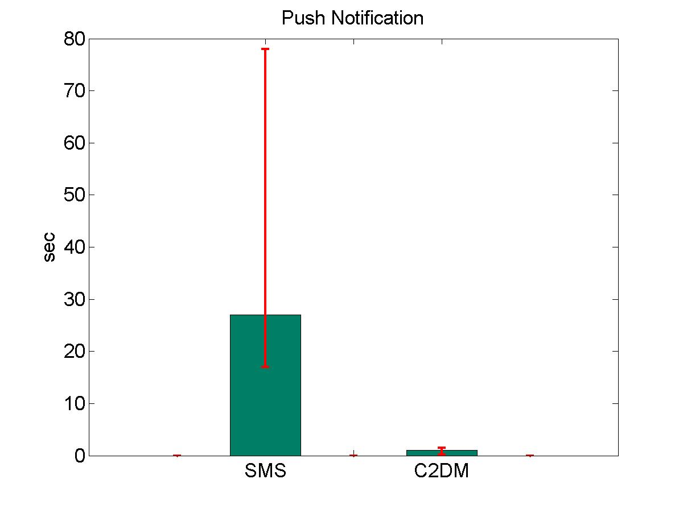
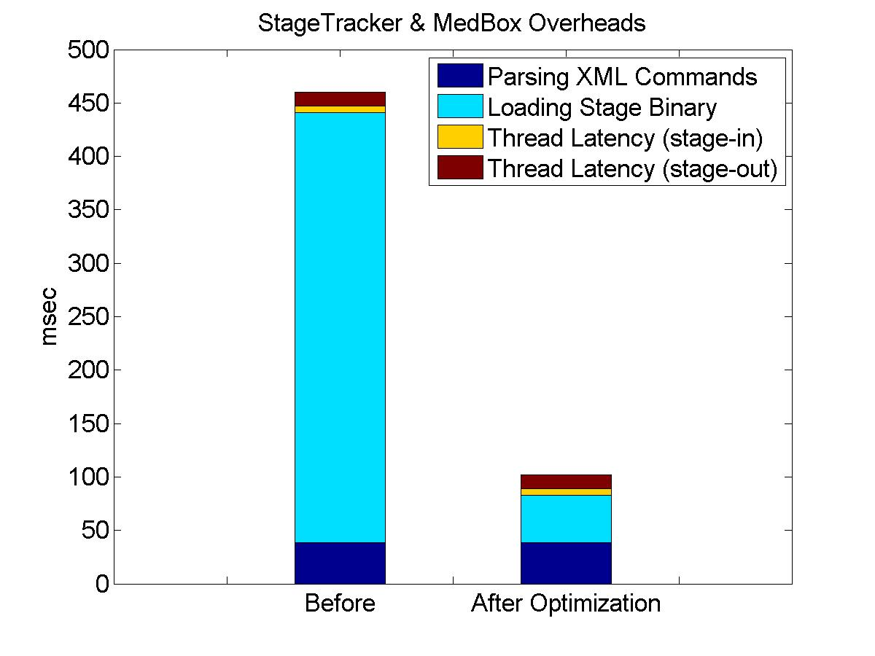
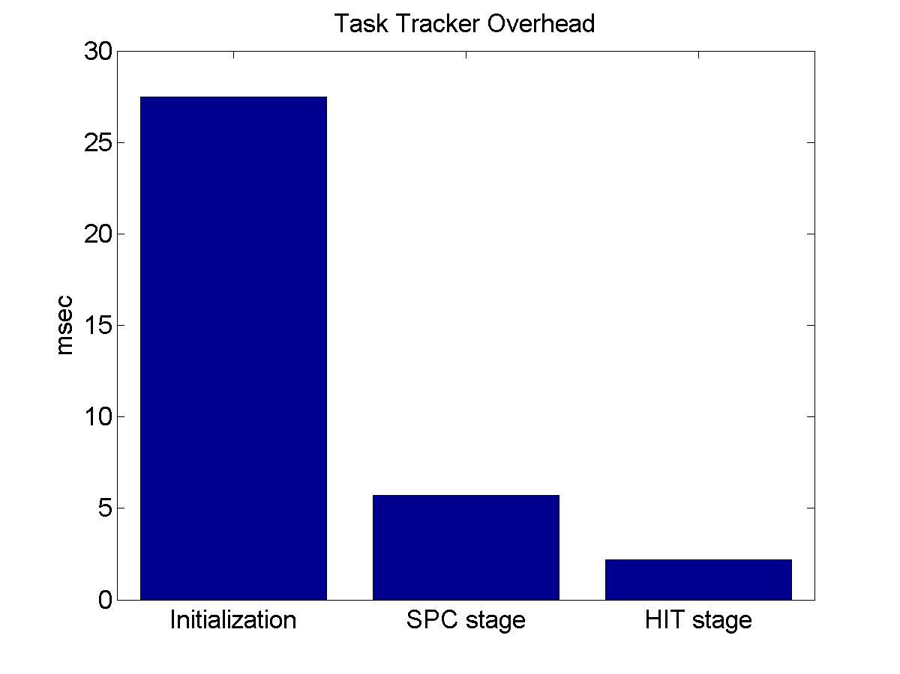
System Performance
Cloud Runtime
Overhead
Medusa runtime has very small overheads.
Mobile Device
Runtime
Overheads
Notification
Delay
~30ms initialization delay, 5ms for tracking stage
Total runtime delay is only 100ms per stage.
C2DM gives much less latency
Motivation
Problem
Design
Evaluation
Conclusion

Slide 18
Related Work
Crowd-Sourcing
Smartphone Sensing
Amazon Mechanical Turk
PEIR, MobiSys’09
CrowdDB, SIGMOD’11
SoundSense, MobiSys’09
Turkit, UIST’10
AnonySense, MobiSys’08
CrowdSearch, MobiSys’10
PRISM, MobiSys’10
Medusa
Human-in-the-loop
Incentives
In-network
Processing
Sensing
Motivation
Problem
Design
Evaluation
Conclusion

Slide 19
Summary
Medusa: A High-Level Programming Framework
for Crowd-Sensing Applications
Identified requirements and principles to design high-level programming framework for crowd-sensing applications.
Design and implementation of the Medscript programming language and associated runtime system.
Prototyped 10 crowd-sensing applications.
Code
http://code.google.com/p/medusa-crowd-sensing/
Demo Video
http://youtu.be/jL1dGA21ciA

