Slide 1
P3: Toward Privacy-Preserving Photo Sharing
Moo-Ryong Ra, Ramesh Govindan, and Antonio Ortega
Networked Systems Laboratory & Signal and Image Processing Institute
University of Southern California

Slide 2
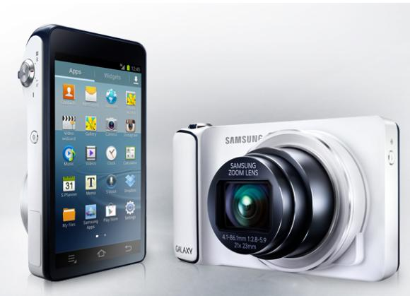
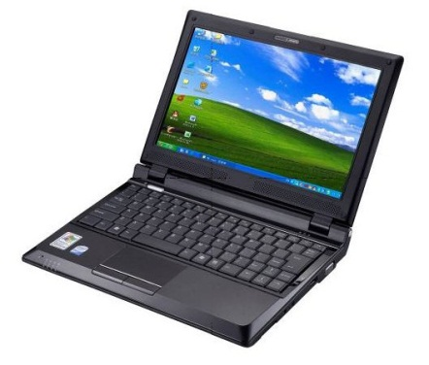
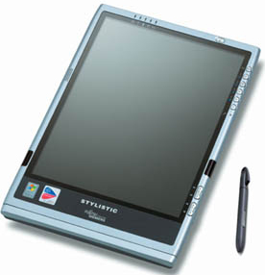
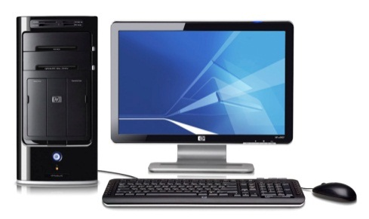
Cloud-based Photo Sharing Services (PSPs)
PSPs
However, there are serious privacy concerns

Slide 3
The Case of Privacy Infringement by PSPs
Alice must be interested
in this handsome guy.
PSPs
Image link is
open to public.
Mining
Link Leakage
Alice
Friends
Today we have no choice but to trust PSPs

Slide 4
These Privacy Concerns Are Real
CNN.com, August 9, 2012
Wall Street Journal, June 8, 2011
New York Times, August 15, 2012
NBC News, December 19, 2012

Slide 5
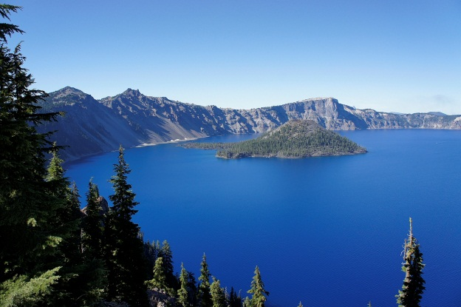
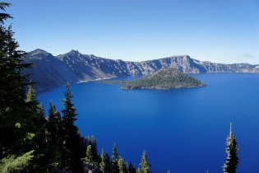
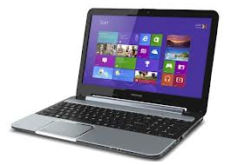
Cloud-side Processing for Mobile Devices
Alice
Friends
Cloud-side processing is often useful
for mobile devices in many ways

Slide 6
Question: Can we protect users’ privacy
while still performing
cloud-side image transformation?

Slide 7
Full Encryption?
You
Your Friends
We will lose benefits
provided by cloud-side processing

Slide 8
Goals, Threat Model, and Assumptions
Preserving users’ privacy
with cloud-side processing
Privacy and Attack Model
Unauthorized access
Algorithmic recognition
PSPs
We trust
Mobile devices’ HW and SW
We don’t trust
Eavesdropper on the network
“Honest-but-curious” PSPs

Slide 9
High-level Description of Our Approach
PSPs
SECRET PART
PUBLIC PART
Bob
Alice
Enhancement
Layer (JPEG)
+
Least Significant Bits
Most Significant Bits

Slide 10
P3 Requirements
PSPs
Storage
Standard
Compliancy
Cloud-side
Processing
Our algorithm and system,
collectively called P3,
realizes this capability
Lightweight
Processing
Bob
Alice
Privacy
Transparent
Deployment

Slide 11
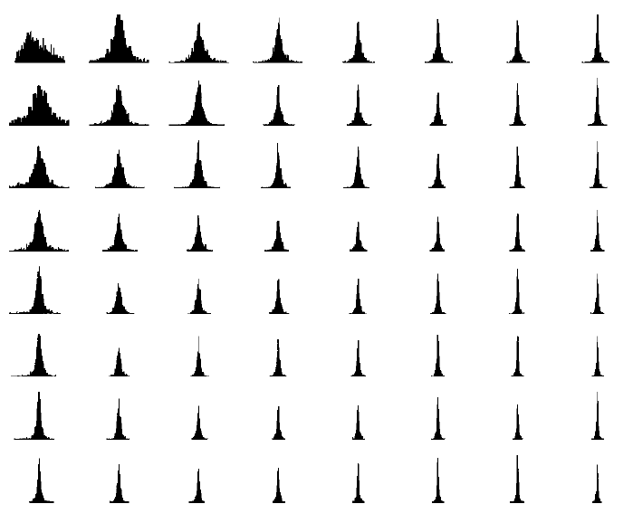
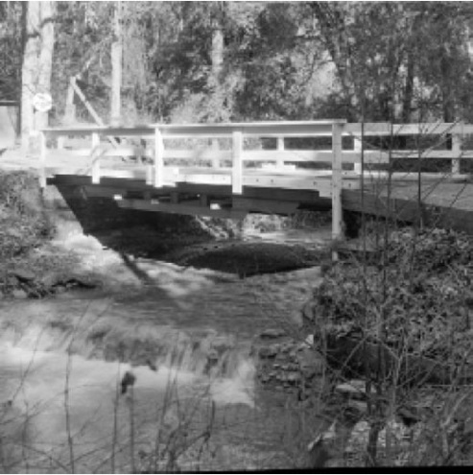
P3 Algorithm: Why It Works
Exploiting the characteristics of DCT coefficients in JPEG.
P3 exploits all three facts
to make a public part much less informative
More
Energy
Lam and Goodman, “A Mathematical Analysis of the DCT Coefficient Distributions for Images”, ITIP 2000
Sparseness
Sign
Magnitude

Slide 12
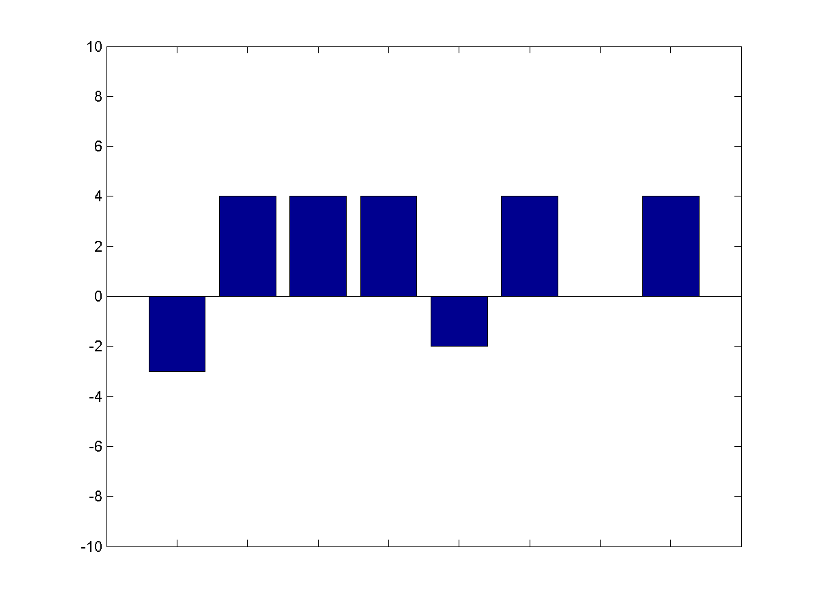
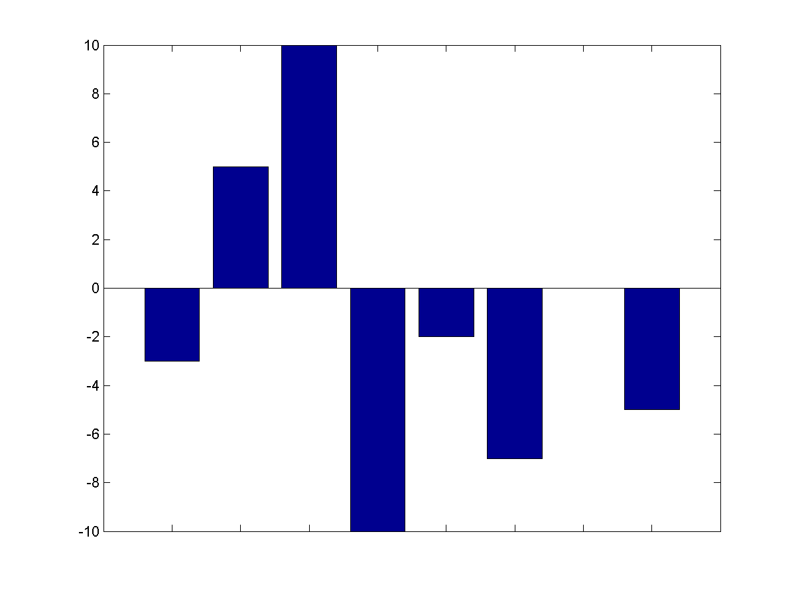
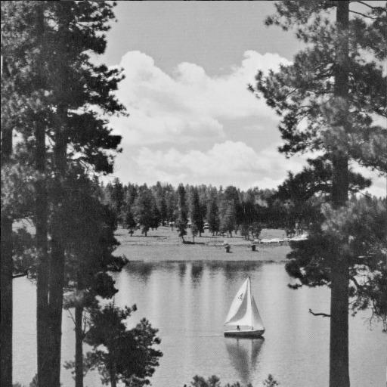
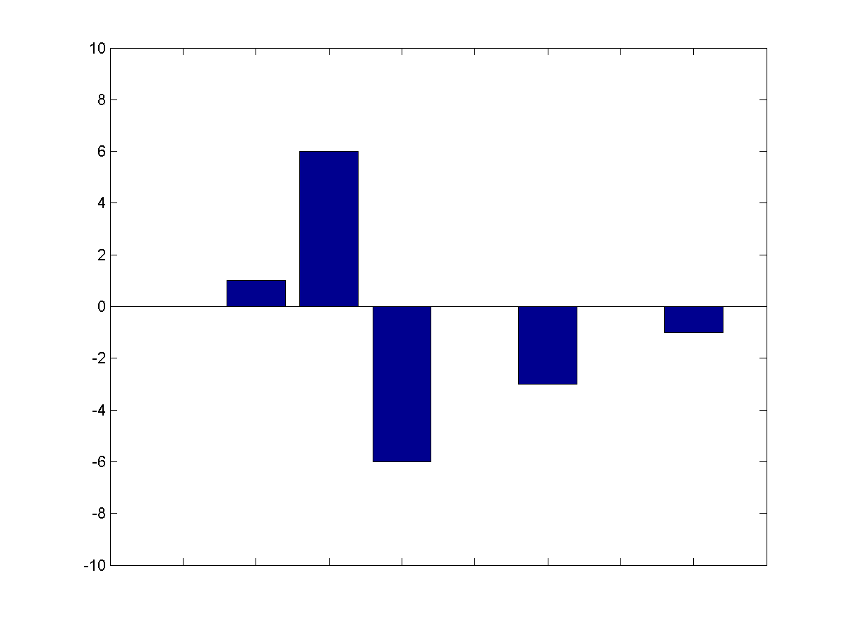
P3 Algorithm: How the encryption works
AC coefficients
Values <= T
T
-T
Public
Values > T
Quantized
Coefficients
Original
Image
Secret
DC
Coefficients

Slide 13
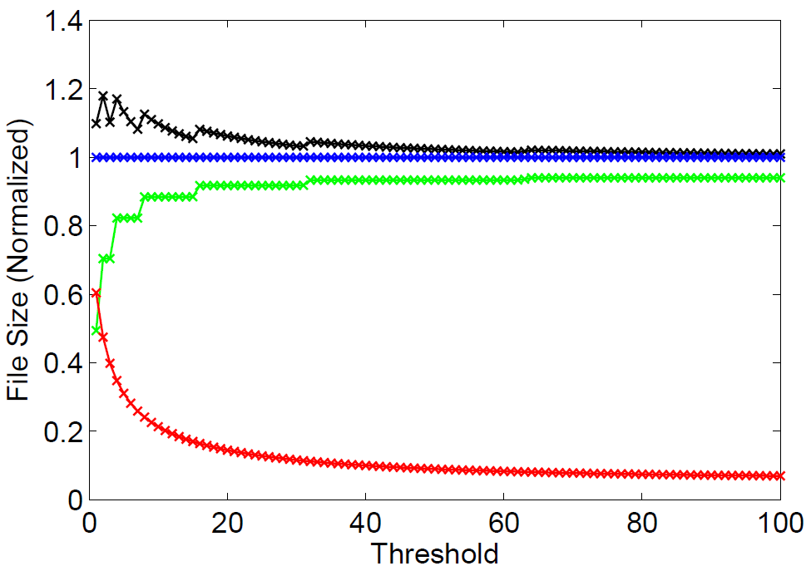
Threshold vs. Storage Trade-off
INRIA dataset (1491 images)
P3

Slide 14
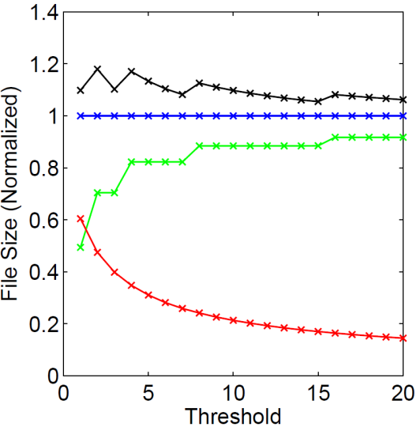
Privacy: What is exposed?
Original
Secret Part (T=1)
Secret Part (T=5)
Secret Part (T=10)
Secret Part (T=15)
Secret Part (T=20)
Public Part (T=20)
Public Part (T=15)
Public Part (T=10)
Public Part (T=5)
Public Part (T=1)

Slide 15
P3 Decryption Challenge
Secret
Part (S)
(Y)
P3
Encrypt
P3
Decrypt
Cloud-side
Processing
(A)
Cloud-side
Processing
f
Public
Part (P)
Alice
Bob
Challenge: Given S and f(P), can we get f(Y)?
We need to perform careful analysis
since P3 encryption hides sign information.

Slide 16
Addressing P3 Decryption Challenge
Challenge: Given S and f(P), can we get f(Y)?
Original
Image
(Y)
Secret
(S)
Public
(P)
Comp
(C)
Analysis Result: C can be derived from S
P3 can handle ANY linear processing
Scaling
Cropping
Sharpening
Blending
Smoothing

Slide 17
P3 System Architecture
PSPs
Public parts
Storage
Service
Encrypted
secret parts
Sender
P3 Trusted
On-device Proxy
Recipients
P3 encryption
P3 decryption
PSPs’ Apps
PSPs’ Apps
P3 can be implemented with existing PSPs
without causing infrastructure changes

Slide 18
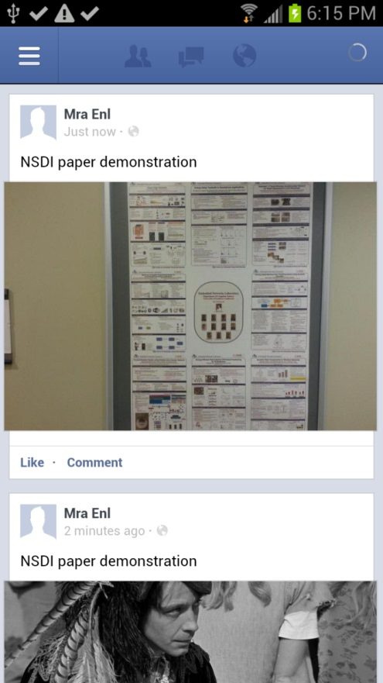
Prototype on Android Phone
With P3
Without P3
P3 is practical and can be added to Facebook
Category | Average | Stdev
P3 Encryption | 152.7 ms | 20.87
P3 Decryption | 191.85 ms | 24.83

Slide 19
Evaluating Privacy
Objective metric
PSNR
Computer vision algorithms
SIFT feature detection
Edge detection: Canny
Face detection: Haar
Face recognition: EigenFace
P3 preserves privacy against algorithmic attacks

Slide 20
Results: Face Recognition
EigenFace [Turk et al. 1991] with the Color FERET database
CSU’s face recognition evaluation system
4 probing (testing) sets
2 distance metrics (Euclidean, MahCosine)
Different P3 thresholds from 1 to 100
Public parts as a training set

Slide 21
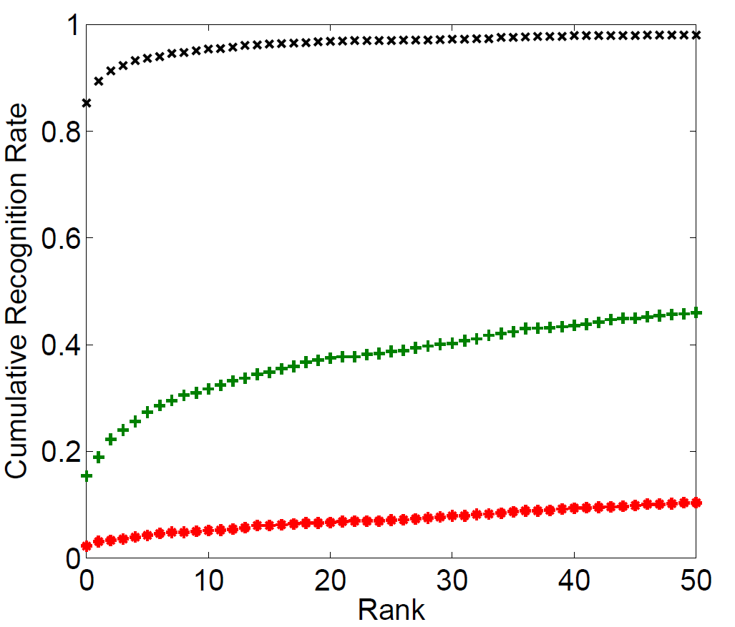
P3 Successfully Breaks Face Recognition
Face recognition
doesn’t work

Slide 22
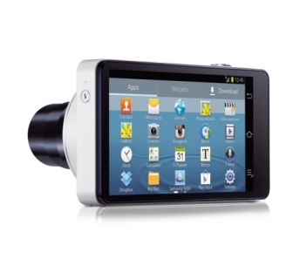
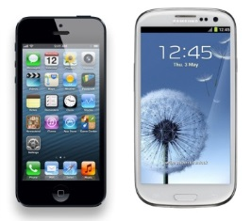
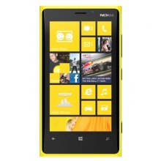
Summary and Contributions
Our algorithm and system, collectively called P3,
provides privacy-preserving photo sharing
Propose a novel photo encryption/decryption algorithm.
Transparent system design that can work with existing PSPs.
A complete prototype and extensive privacy evaluation using computer vision-based recognition algorithms.

